Slide 1

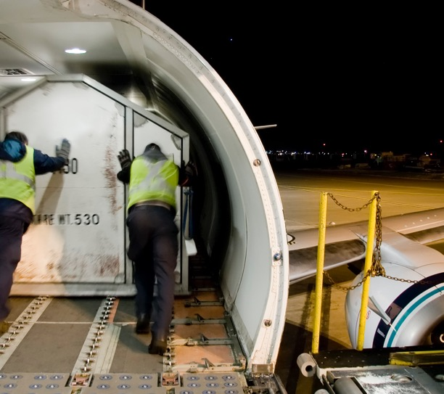
Session 7

Slide 2
Session Overview
Outcomes
The team will create their project solution and complete the Innovation Project Planning page.
The team will design and create a robot to complete Robot Game missions.

Slide 3
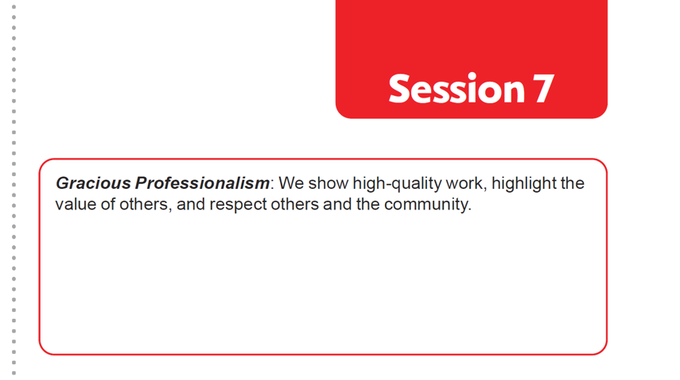

Introduction
Think about Gracious Professionalism®.
Write ways your team will demonstrate this in everything you do.
Notes:
Facilitator Tips
Give the team multiple copies of the Pseudocode page to plan out multiple runs.

Slide 4
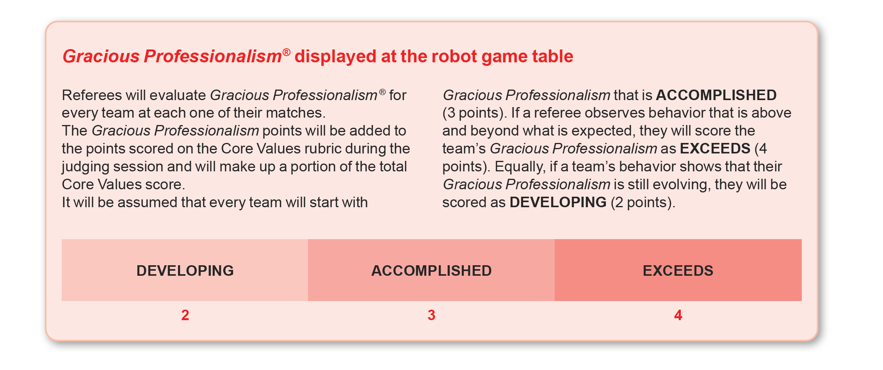
Introduction
Look over pages 21 and 31 in the Robot Game Rulebook to see how Gracious Professionalism® is evaluated during the tournament.
Notes:
Facilitator Tips

Slide 5
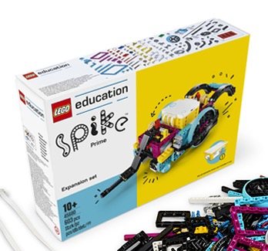
Solve Missions
Design and create your robot that can attempt the missions in the Robot Game. You can also improve the existing robot used in the previous sessions.
Create a program for each new mission you attempt. You could combine mission solutions into one program.
Test and improve your robot and its programs.
Develop your coding skills by revisiting the lessons in the app.
Revisit previous lessons, advance through the rest of the unit, or work on solving the missions.
Notes:
Facilitator Tips
Different members of the team can be responsible for specific missions and develop and own the robot run of those missions.
Once the team has a base robot, do a straight drive test. If it doesn’t go straight, look at the robot’s center of gravity and balance.
Have the team choose a starting position that is easy to find and leaves enough room for the whole robot to fit inside the Launch Area.
Encourage the students to explain the code as the robot moves.

Slide 6
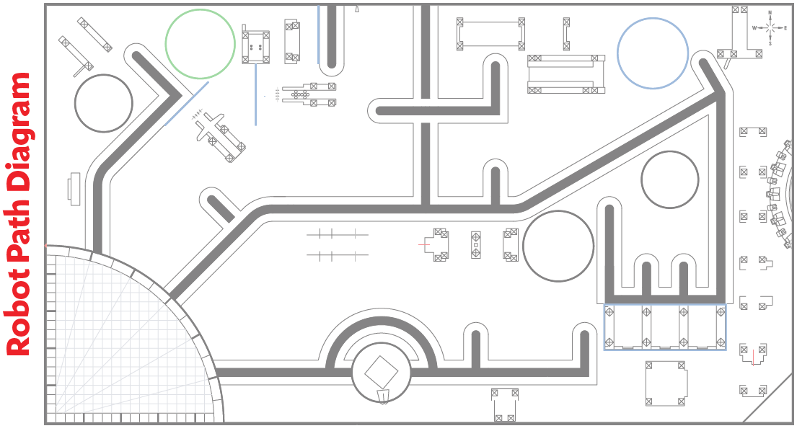
Solve Missions

Slide 7

Solve Missions
Reflection Questions
Can you follow how the code on your device is making your robot move?
How can you iterate and improve on the existing Robot Design used in previous sessions?
You could modify the existing robot you’ve used in past sessions.

Slide 8
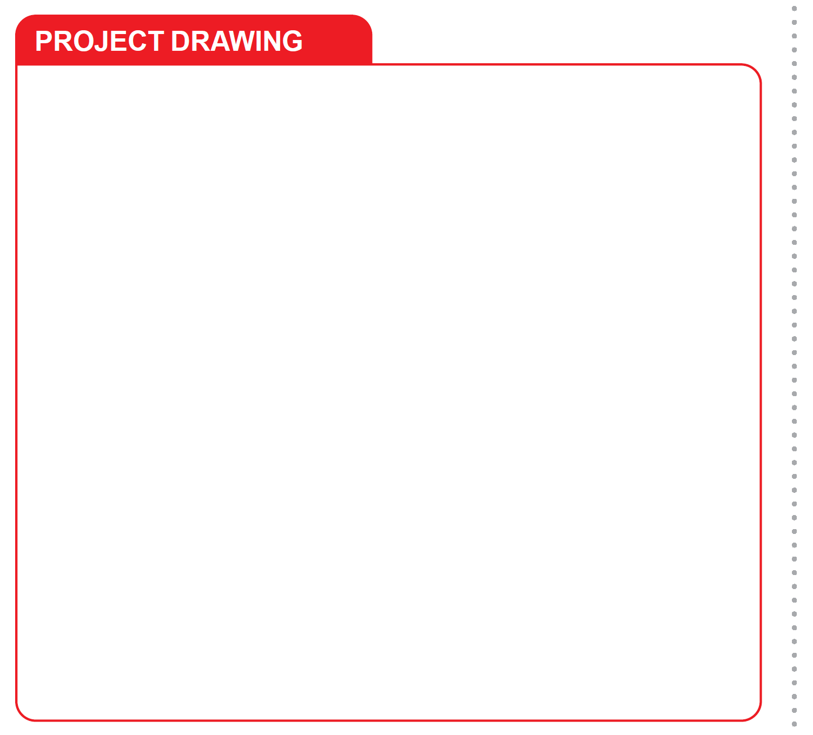
Develop Project Solution
Develop and create your project solution.
Sketch your solution. Label the parts and how it will work.
Notes:
Facilitator Tips
Provide a variety of materials for the team to use to make a prototype model of their project solution.
A drawing can include a detailed annotated sketch or a computer-aided design (CAD) drawing.

Slide 9
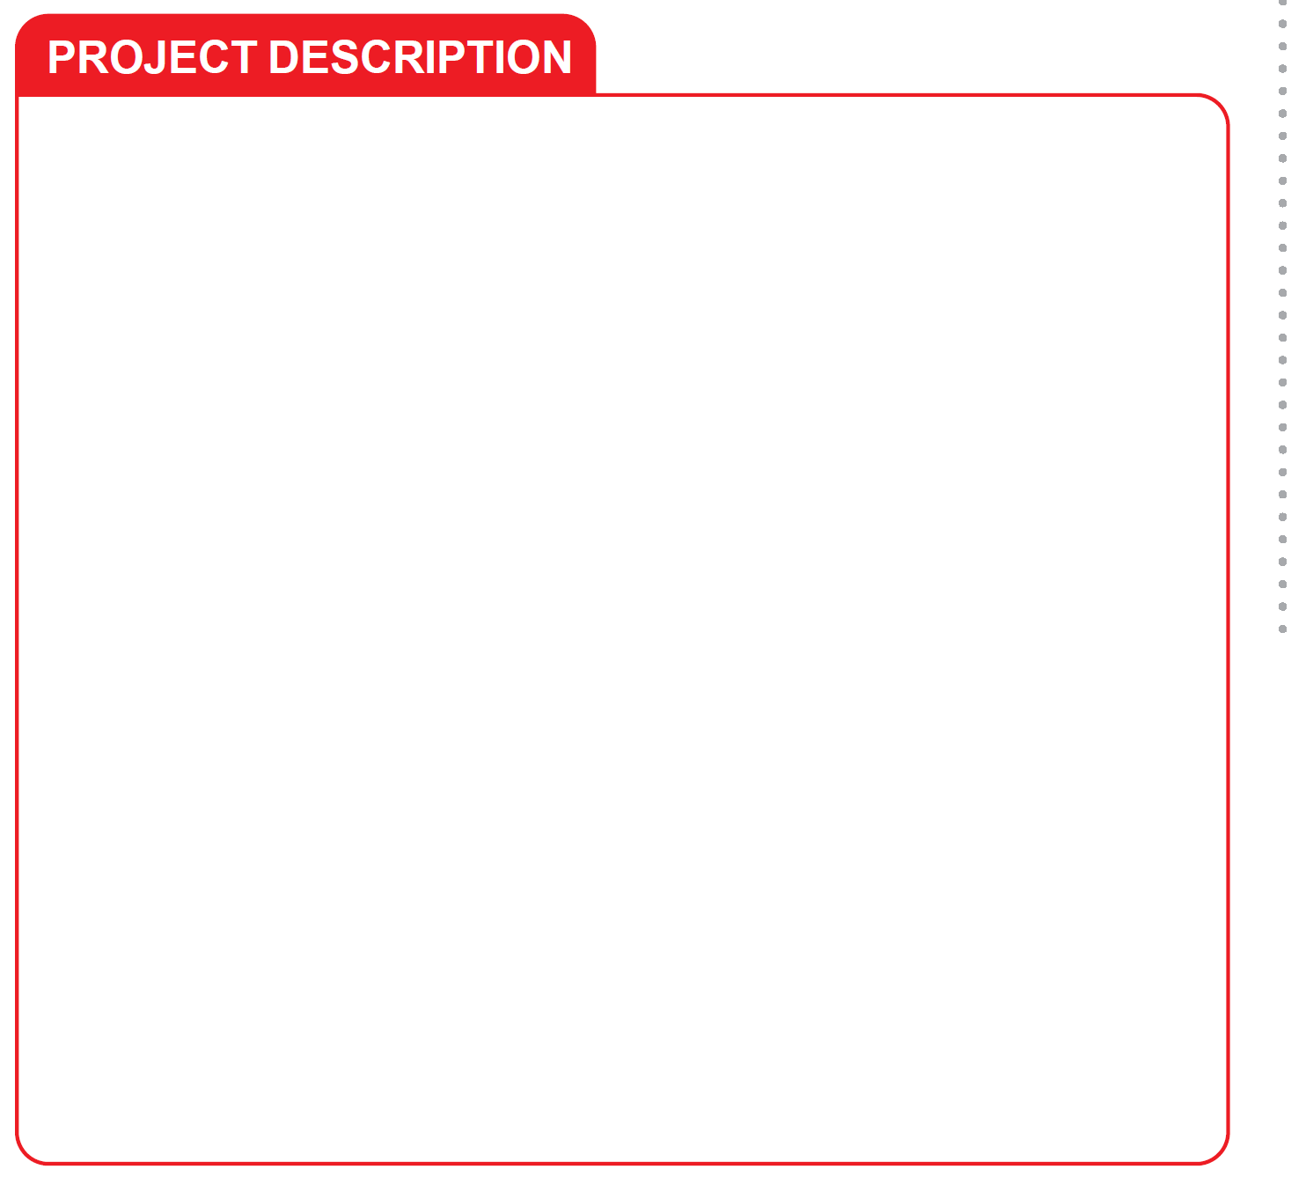
Develop Project Solution
Describe your solution and explain how it solves the problem.
Create a prototype model or drawing of your solution.
Document the process you use to develop your solution on the Innovation Project Planning page 23.
Notes:
Facilitator Tips
Have the team think of people they would like to get feedback from on their solution.
Arrange a visit to look at transportation examples in your community that can be a focus of the project.
Consider inviting an expert to this session to share content about their identified problem.

Slide 10
Share
Get together at the mat.
Show the team any new coding skills you learned.
Discuss your research and your project solution.
Discuss the reflection questions.
Clean up your space.

Slide 11

Reflection Questions
Can you describe your innovative solution and how it solves your problem?
Does your solution involve a piece of equipment or technology?

Slide 12
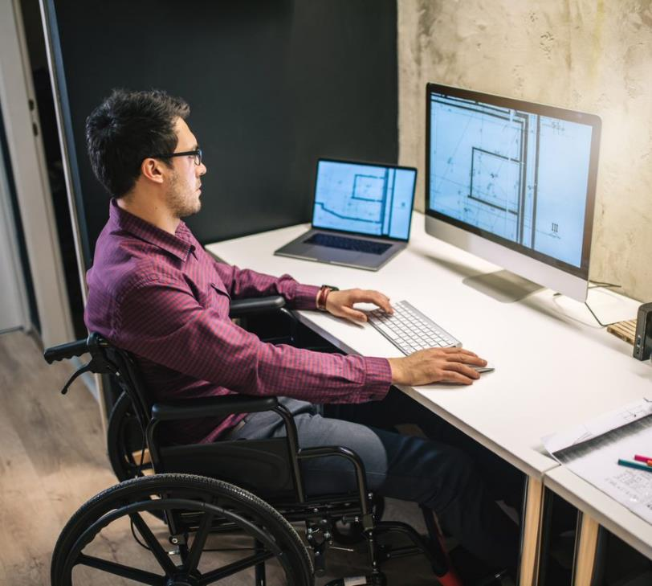
Career Connections
Cargo
Engineer
Warehouse Worker
Role:
Designs ways to safely and efficiently transport cargo.

Slide 13

Multimedia Resources
You may wish to embed a relevant, age-appropriate video for your students here. See the Notes for an example.
Notes:
Choose a relevant, age-appropriate video for your students.
Here is one example:
How Amazon Delivers Packages So Fast from Tech Vision – Length 5:18
https://youtu.be/91jKeKuUaDM

Slide 14

Clean Up

Slide 15

FIRST® and the FIRST® logo are registered trademarks of For Inspiration and Recognition of Science and Technology (FIRST). LEGO® and MINDSTORMS® are registered trademarks of the LEGO Group. FIRST® LEGO® League and CARGO CONNECTSM are jointly held trademarks of FIRST and the LEGO Group. SPIKE™ Prime is a trademark of LEGO® Education. All other trademarks are the property of their respective owners. ©2021 FIRST and the LEGO Group. All rights reserved.

